Slide 1
Statistics
Descriptive Statistics

Slide 2
summarize categorical data
Frequency distribution.
Frequency distribution A frequency distribution is a tabular summary of data showing the number (frequency) of items in each of several non overlapping classes.

Slide 3
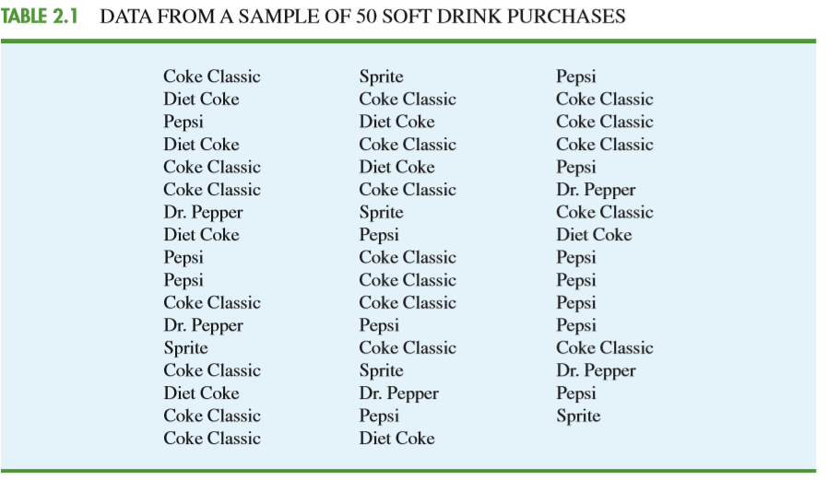
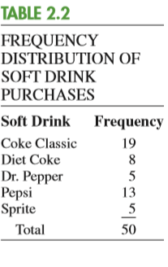

Slide 4
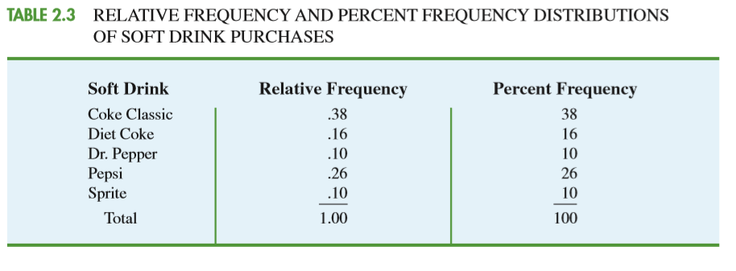
For Charts

Slide 5
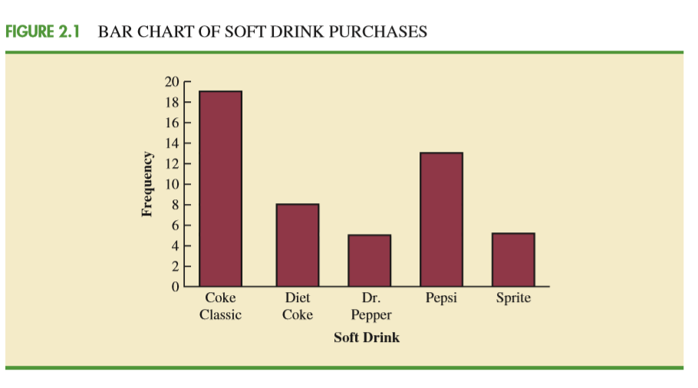

Slide 6
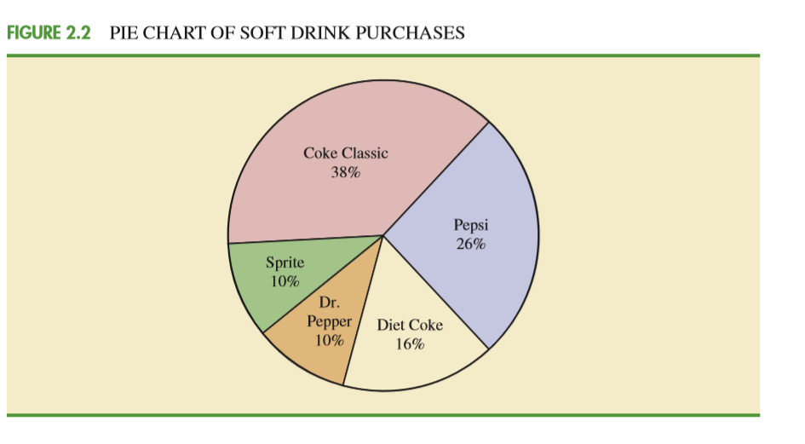

Slide 7
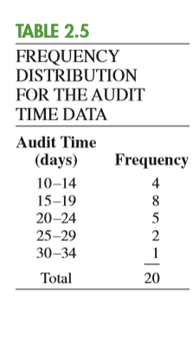
1. Determine the number of non-overlapping classes.
2. Determine the width of each
class.
3. Determine the class limits.

Slide 8
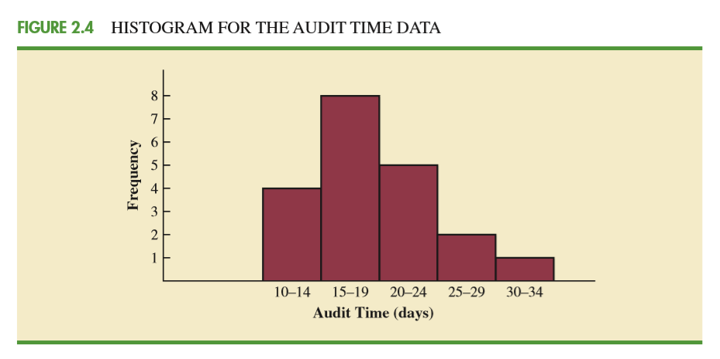
Histogram

Slide 9
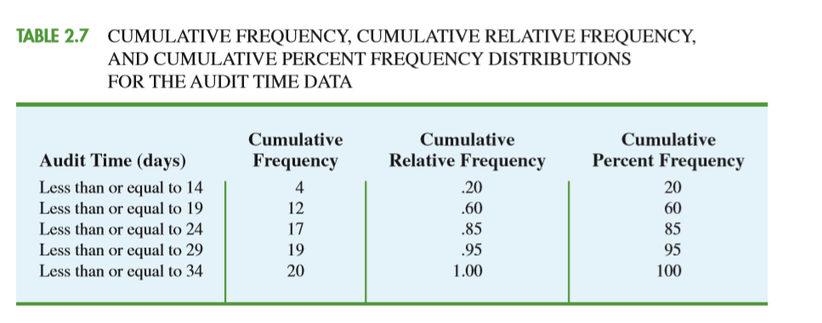
cumulative frequency distribution.
A variation of the frequency distribution that provides another tabular summary of quantitative data is the cumulative frequency distribution.

Slide 10
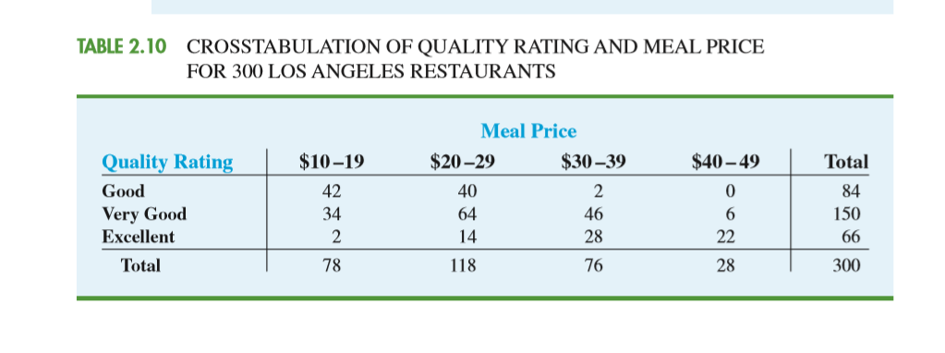
Cross tabulation
A cross tabulation is a tabular summary of data for two variables.

Slide 11
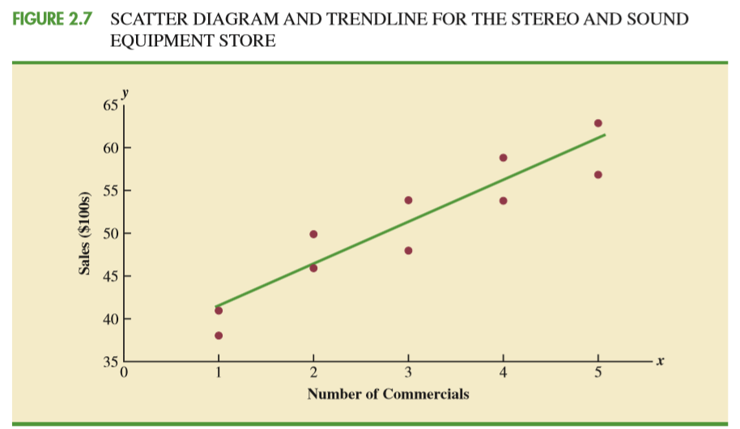
Scatter Diagram

Slide 12
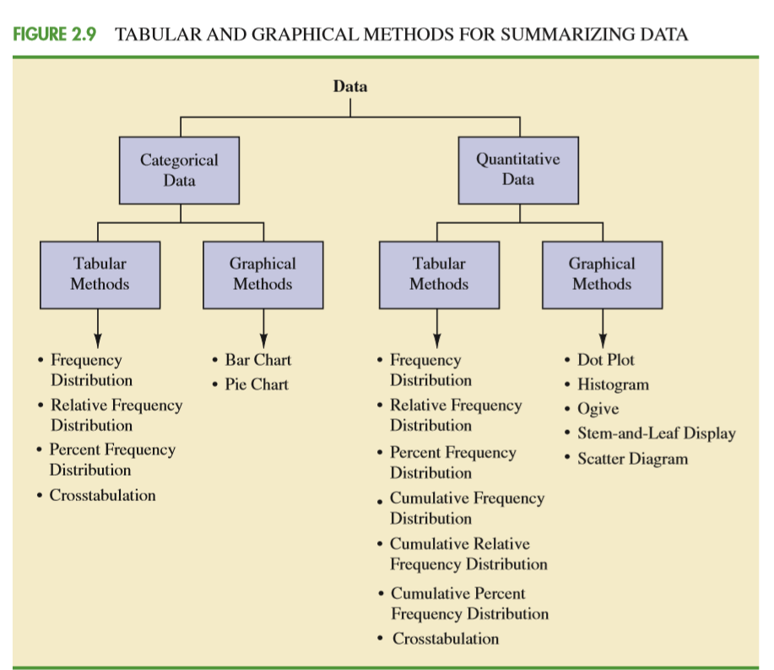

Slide 13
Numerical Measures -> Next ppt

